Slide 1

Data Analysis with SQL
by – Lathish Gajula

Slide 2
- overview
This project involves a comprehensive analysis of Netflix's movies and TV shows data using SQL. The goal is to extract valuable insights and answer various business questions based on the dataset
- objectives
Analyze the distribution of content types (movies vs TV shows).
Identify the most common ratings for movies and TV shows.
List and analyze content based on release years, countries, and durations.
Explore and categorize content based on specific criteria and keywords.

Slide 3
10 Business Problems and Solutions

Slide 4
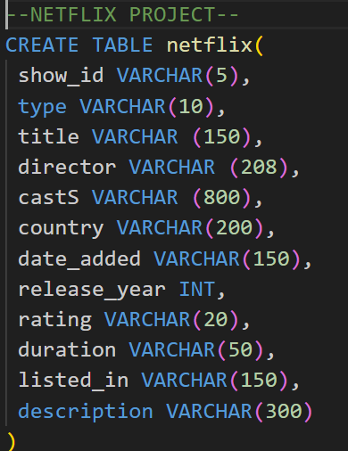
Schema
of the dataset

Slide 5
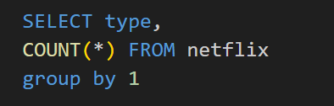
1. Count the Number of Movies vs TV Shows
Objective: Determine the distribution of content types on Netflix.

Slide 6
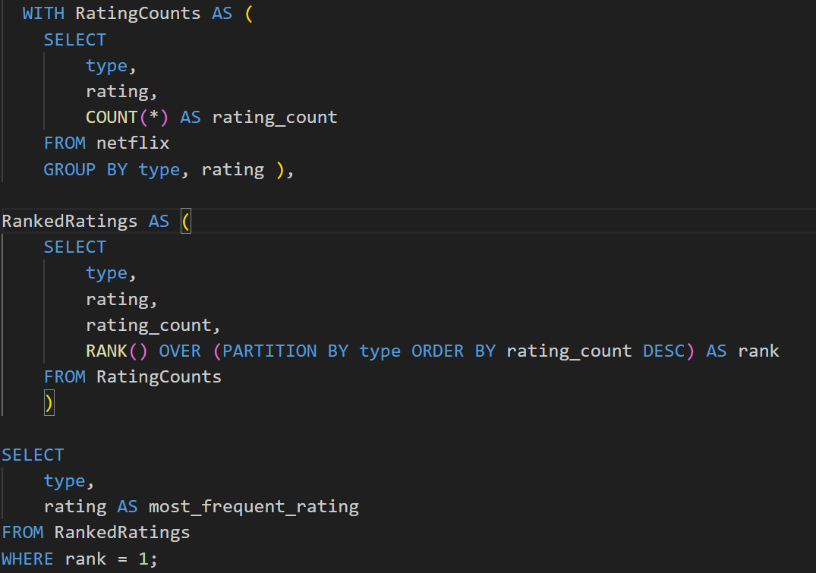
2. Find the Most Common Rating for Movies and TV Shows
Objective: Identify the most frequently occurring rating for each type of content.

Slide 7
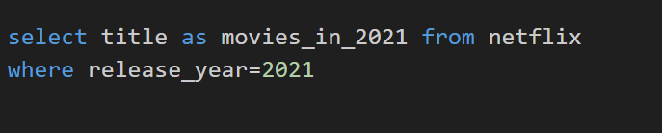
3. List All Movies Released in a Specific Year (e.g., 2021)
Objective: Retrieve all movies released in a specific year

Slide 8
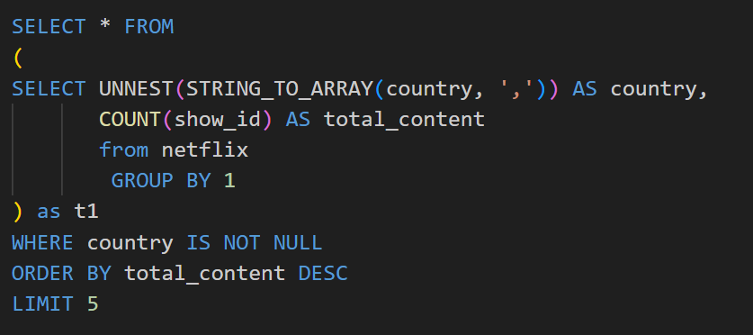
4. Find the Top 5 Countries with the Most Content on Netflix
Objective: Identify the top 5 countries with the highest number of content items.

Slide 9
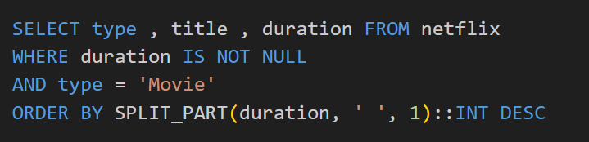
5. Identify the Longest Movie
Objective: Find the movie with the longest duration.

Slide 10
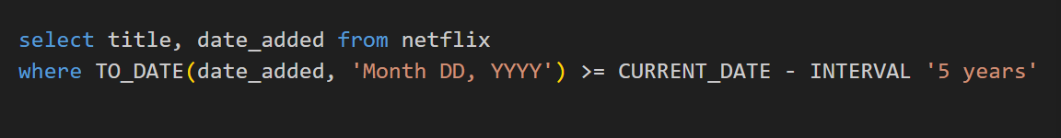
6. Find Content Added in the Last 5 Years
Objective: Retrieve content added to Netflix in the last 5 years.

Slide 11
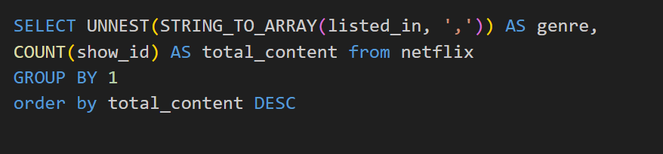
7. Count the Number of Content Items in Each Genre
Objective: Count the number of content items in each genre

Slide 12
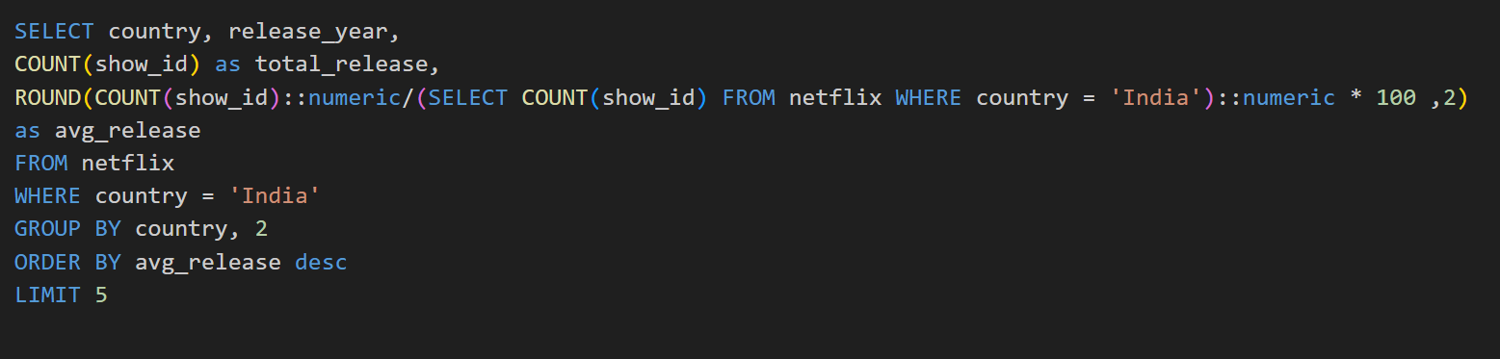
8.Find each year and the average numbers of content release in India on netflix.
Objective: Calculate and rank years by the average number of content releases by India.

Slide 13
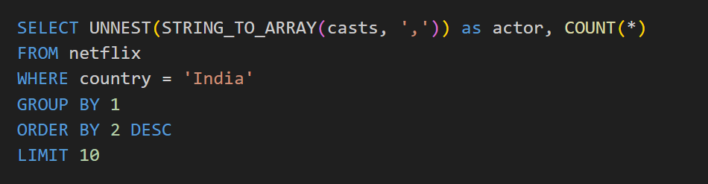
9. Find the Top 10 Actors Who Have Appeared in the Highest Number of Movies Produced in India
Objective: Identify the top 10 actors with the most appearances in Indian-produced movies.

Slide 14
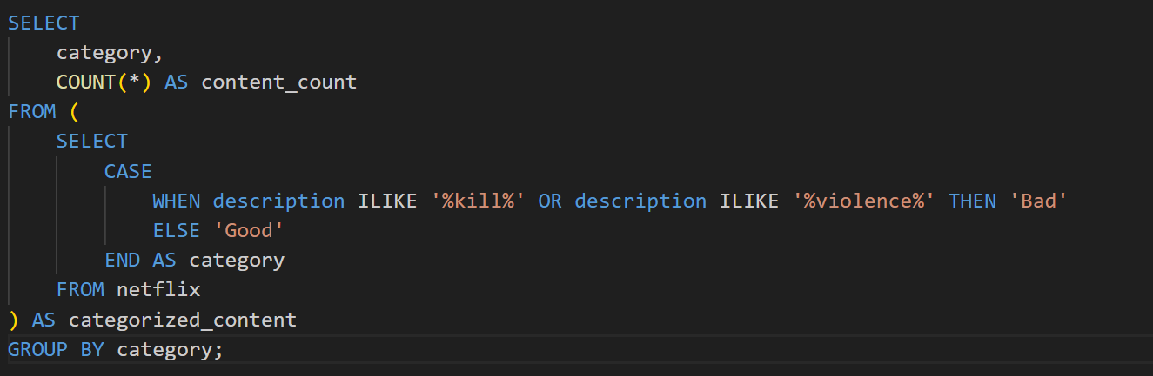
10. Categorize Content Based on the Presence of 'Kill' and 'Violence' Keywords
Objective: Categorize content as 'Bad' if it contains 'kill' or 'violence' and 'Good' otherwise.
Count the number of items in each category.

Slide 15
Insights and Conclusion
Content Distribution: The dataset contains a diverse range of movies and TV shows with varying ratings and genres.
Common Ratings: Insights into the most common ratings provide an understanding of the content's target audience.
Geographical Insights: The top countries and the average content releases by India highlight regional content distribution.
Content Categorization: Categorizing content based on specific keywords helps in understanding the nature of content available on Netflix.
This analysis provides a comprehensive view of Netflix's content and can help inform content strategy and decision-making.

